Slide 1
Liver Metabolomics Analysis in Mouse Model of Fentanyl Overdose Treated with Beta-Lactam
Presented by:
Abdulrahman Alhumaydhi, Bandar Arif
Supervised by:
Dr. Fawaz Alasmari

Slide 2
Outlines
Introduction
Methods
Discussion
1
3
5
2
4
6
Objectives
Results
Conclusion

Slide 3
Introduction
1

Slide 4
Introduction
Opioids are a class of drugs that include Semisynthetic drugs like heroin, synthetic opioids such as fentanyl, and pain relievers available legally by prescription, such as oxycodone (OxyContin®), hydrocodone (Vicodin®), codeine, morphine, and many others.
Opioids misuse can cause respiratory depression leading to death. Naloxone is an opioid receptor antagonist that can reverse the effects of opioid overdoses, but its effectiveness can be compromised if high doses or long-acting formulations of opioids have been taken. Therefore, investigating the molecular pathways involved in opioid overdoses is crucial to develop potential therapeutic strategies. The recent rise in fentanyl overdoses is mainly driven by illicitly manufactured fentanyl (IMF), which is frequently mixed with other drugs, making them more effective and addictive.

Slide 5
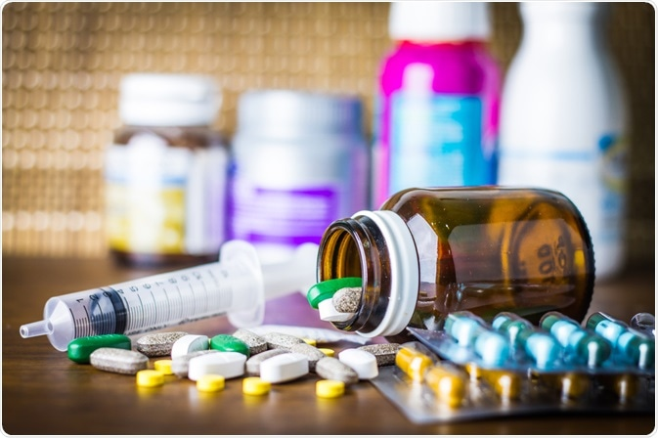
Introduction
The study focuses on using metabolomic analysis to determine biomarkers in tissues that are mainly end or intermediate metabolites of different biological pathways. It investigates the modulatory effects of MC-100093 and ceftriaxone on liver metabolites in mice exposed to fentanyl overdose.
MC-100093 is a synthetic beta-lactam compound that has been found to attenuate substance abuse-seeking behaviors by upregulating GLT-1 in the brain, and in this study, it was investigated whether it could also modulate liver metabolites in mice exposed to fentanyl overdose.

Slide 6
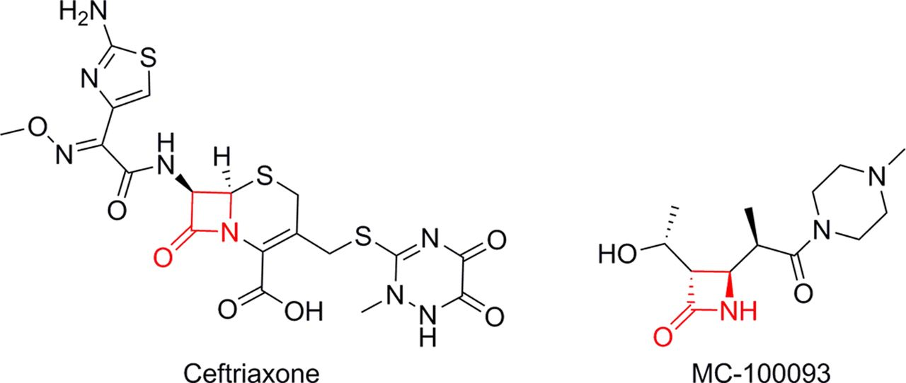
Introduction

Slide 7
Objectives
Determine the liver metabolomic profile of opioid overdose model.
Elucidate the therapeutic effect of glutamate transporter upregulators on metabolomic changes of opioid overdose model.
To determine and compare the effects of the two B-lactams, Ceftriaxone and MC100093 across these profiles.

Slide 8
Methods
2

Slide 9
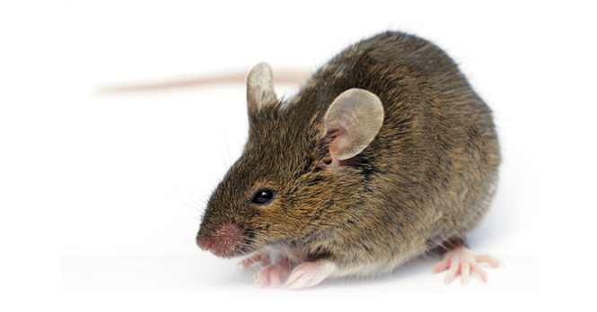
Methods
36 mice were divided into 4 groups: Control, Fentanyl, Fentanyl+Ceftriaxone, Fentanyl+MC.
Fentanyl and treatments were administered for a total of 9 days, with the injections being on alternate days, while control group received normal saline.
Post-injection metabolomic analysis of 35 metabolites.
Gas Chromatography Mass Spectrometry (GC-MS) was used to measure different metabolites in the brain.

Slide 10
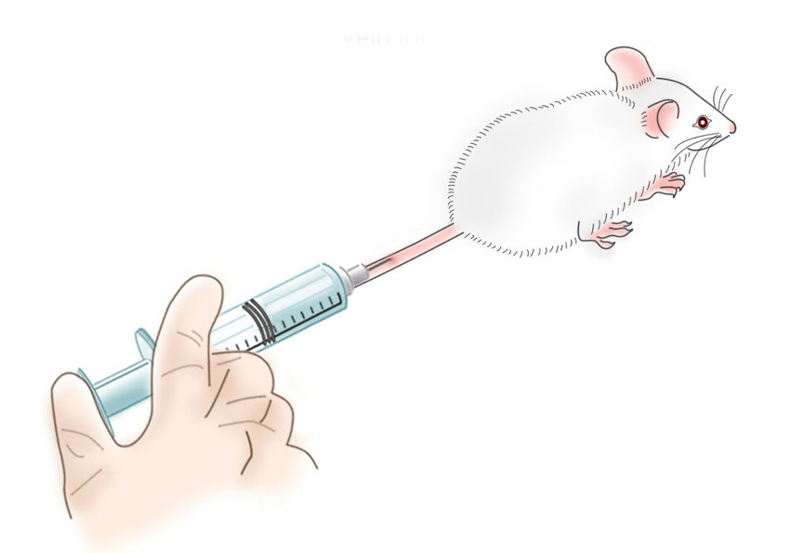
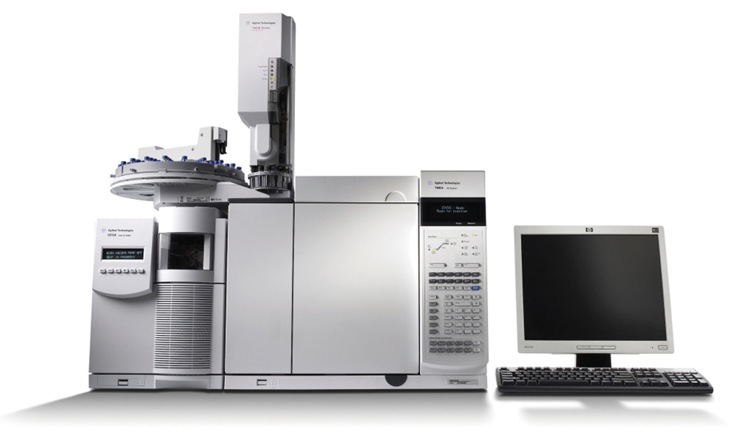
Experimental timeline
Begin injections
Injections on alternate days
Overdose
Sacrificing
Metabolomic analysis
Day 1
Day 3,5,7
Day 9
Day 10,11,12
Post-
injection
Normal Saline 200- 250mcg/mice
Fentanyl 50mcg/kg
Ceftriaxone 200mg/kg
MC100093 200mg/kg
Fentanyl 500 mcg/kg

Slide 11
Methods Statistical Analysis
The statistical analysis of metabolomic profiles of the four groups was done by using GraphPad Prism software
A one-way ANOVA test was used to determine the significance of metabolite peak area ratios among the groups.
The Newman-Keuls multiple comparisons test was used to test the statistical significance of metabolites between the four groups.
The analysis aimed to identify significant differences in the metabolomic profiles of the four groups and determine which metabolites were responsible for those differences.

Slide 12
Results
3

Slide 13
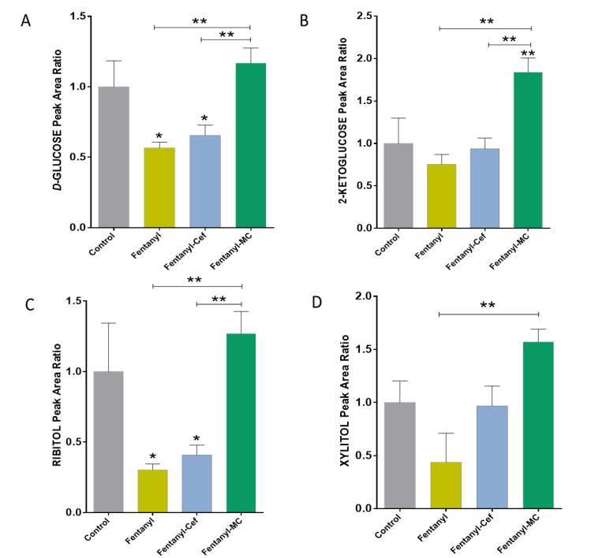
Results Effects of Fentanyl, Ceftriaxone, and MC-100093 on Selected Sugars

Slide 14
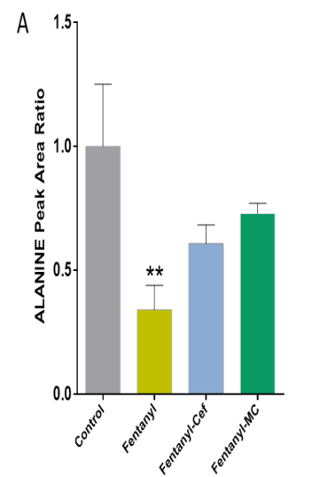
Results Effects of Fentanyl, Ceftriaxone, and MC-100093 on Selected Amino Acids (Alanine, Methionine, Glycine, L-proline, Methylleucine, Phenylethanolamine)

Slide 15
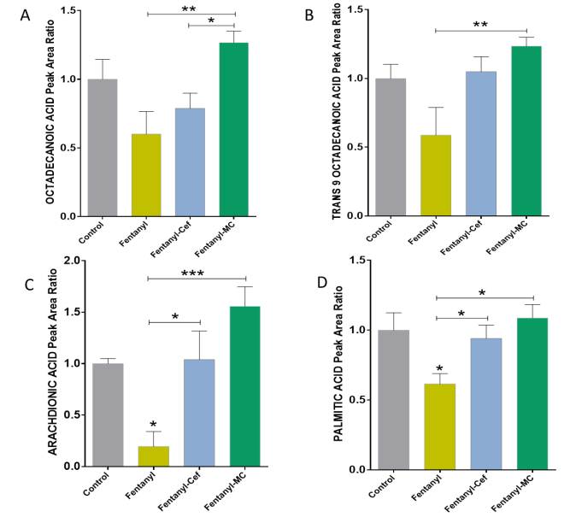
Results Effects of Fentanyl, Ceftriaxone, and MC-100093 on Selected Fatty Acids

Slide 16
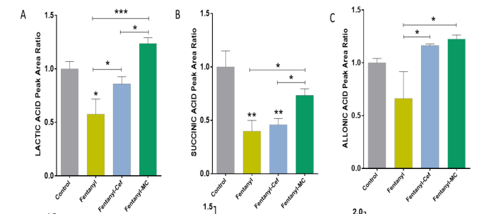
Results Effects of Fentanyl, Ceftriaxone, and MC-100093 on Lactic acid, Succinic acid, Allonic acid, Carbonic acid, Phosphoric acid, 2- Pipecolic acid

Slide 17
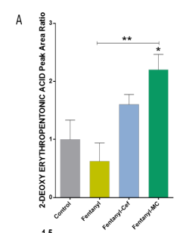
Results Effects of Fentanyl, Ceftriaxone, and MC-100093 on 2-Hexenedioic acid, 2-Ketoisocaproic acid, 2-deoxyerythropentoic acid, octanedioic acid, azelaic acid and pyruvic acid

Slide 18
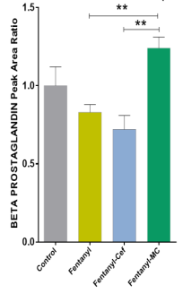
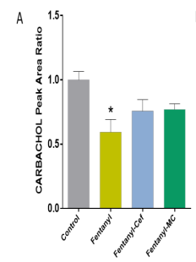
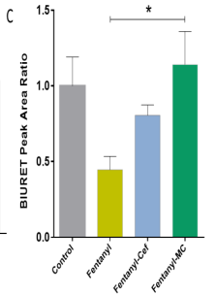
Results Effects of Fentanyl, Ceftriaxone, and MC-100093 on Carbachol, Pentaglycerine, Biuret, Urea and, Beta prostaglandin

Slide 19
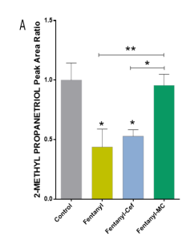
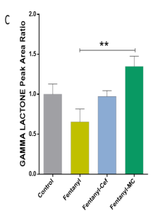
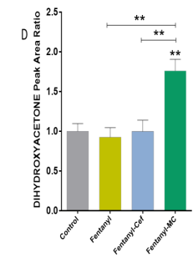
Results Effects of Fentanyl, Ceftriaxone, and MC-100093 on 2-methylpropanetriol, ornithine, gamma lactone, dihydroxy acetone and 4,5 octanediol

Slide 20
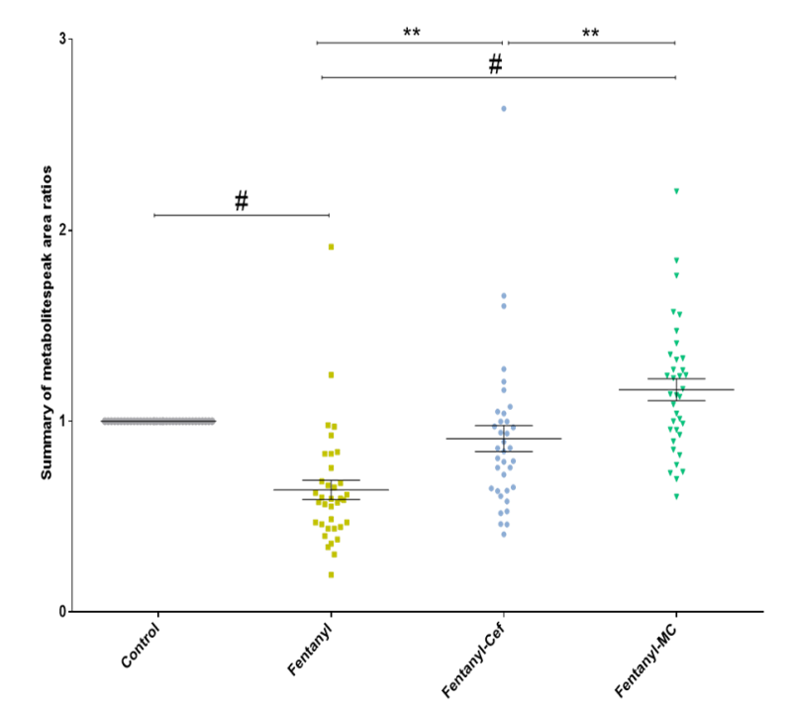
Results Overall Metabolomic Profiling of Fentanyl, Fentanyl-Ceftriaxone and Fentanyl- MC-100093 Groups

Slide 21
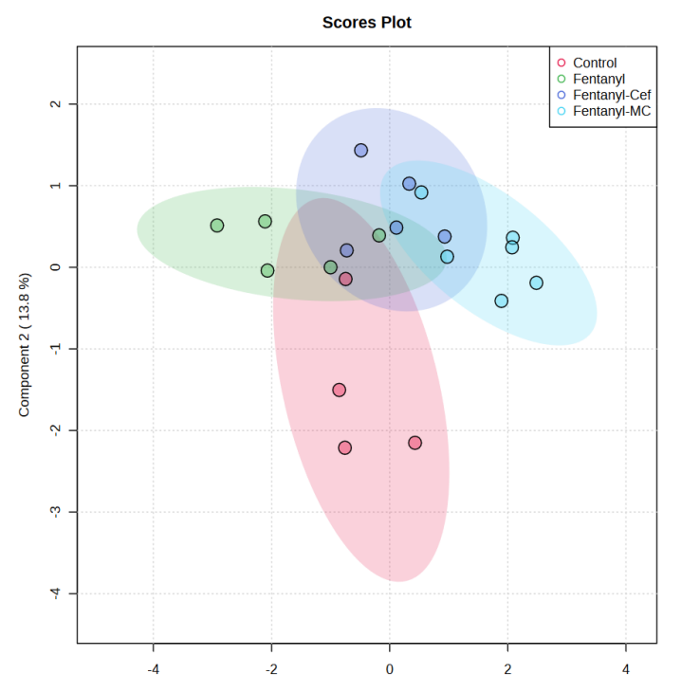
Results Partial Least Squares-Discriminant Analysis Model of Control, Fentanyl, Fentanyl-Ceftriaxone and Fentanyl-MC-100093 Metabolomic Profiles

Slide 22
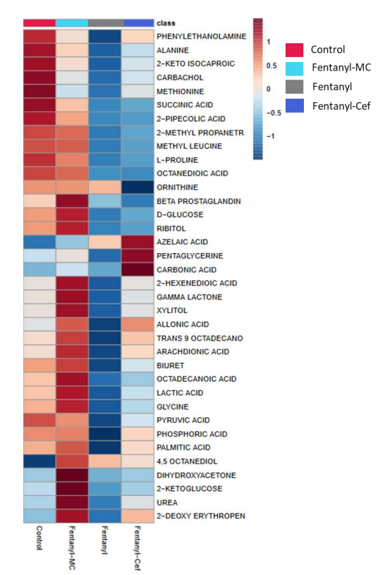
Results Heatmap Analysis Model of Control, Fentanyl, Fentanyl-Ceftriaxone and Fentanyl-MC-100093 Metabolomic Profiles

Slide 23
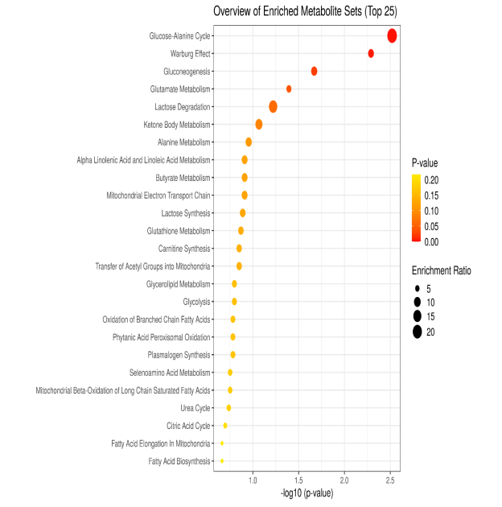
Results Enrichment Pathways Analysis Involved in Altered Metabolites

Slide 24
Discussion/Conclusion
4

Slide 25
Discussion
Fentanyl overdose reduced several metabolite peak area ratios, and MC-100093 and ceftriaxone restored some metabolites.
MC-100093 exhibited superior effects compared to ceftriaxone.
Pathways affected by fentanyl overdose and normalized by beta-lactam treatments include glucose-alanine cycle, Warburg effect, gluconeogenesis, glutamate metabolism, lactose degradation, and ketone metabolomics pathways.

Slide 26
Discussion Significance?
Glutamate plays a role in nitrogen assimilation, nucleoside synthesis, and cofactor biosynthesis, among others. Impairment in these metabolic pathways can be triggered by opioid overdoses
Opioid exposure in prior studies has been associated with increased blood glucose and decreased insulin concentrations, suggesting a link between opioids and glucose metabolism
Enrichment analysis showed that glucose metabolism pathways were the most significantly affected by fentanyl overdose

Slide 27
Discussion Significance?
Fentanyl overdose reduced glucose and ribitol peak area ratios, and MC-100093 treatment reversed this effect
Fatty acids, including arachidonic acid and palmitic acid, decreased in the fentanyl overdose group and were normalized by beta-lactams
Ketone body metabolism pathway was significantly affected by fentanyl overdose
Fatty acids such as arachidonic acid, palmitic acid impacts the formation of cell membranes influencing their physiological functions whereas ketone bodies support bioenergetic homeostasis at organs such as heart or brain

Slide 28
Conclusion
5

Slide 29
Conclusion
MC-100093 reversed many metabolites affected by fentanyl overdose, showing promising potential for treating metabolic abnormalities induced by opioid overdoses.
Further molecular metabolomics studies are needed to investigate the effects of fentanyl overdose and beta-lactams on metabolic pathways at the gene and protein levels.

Slide 30
Questions and discussion
6

Slide 31
Thanks!

